Slide 1
Unit3: Semiconductor, Diode, PN junctions, Diode equation and models.
Unit4: BJT and MOSFET-construction and biasing, small signal model- BJT/MOSFET as a switch. Amplifiers-Transconductance Model, Magnitude and Phase response. MOSFET as invertor and switch. Operational amplifier and its applications.
Unit 5: Communication Systems: Various frequency bands used for communication, Block diagram of Digital communication, need of modulation, Digital modulation techniques (ASK, FSK, PSK).
EE 1118:Fundamentals of Electrical and Electronics Engineering
Reference book :
1. Microelectric Circuits-Sedra and Smith-5 Ed., 2009, Oxford University press

Slide 2
Electronics components

Slide 3
Classification of electronic components
Passive components:
Absorb/dissipate/store power
Practical examples: Incandescent Light bulbs.
Loud speakers
Antennas used in GPS devices, satellites
Resistors, capacitors, inductors
Active components:
Deliver Power Gain. Amplify voltage/current.
Batteries, BJT, MOSFET
Some types of diodes(solar cells, tunnel diode)

Slide 4
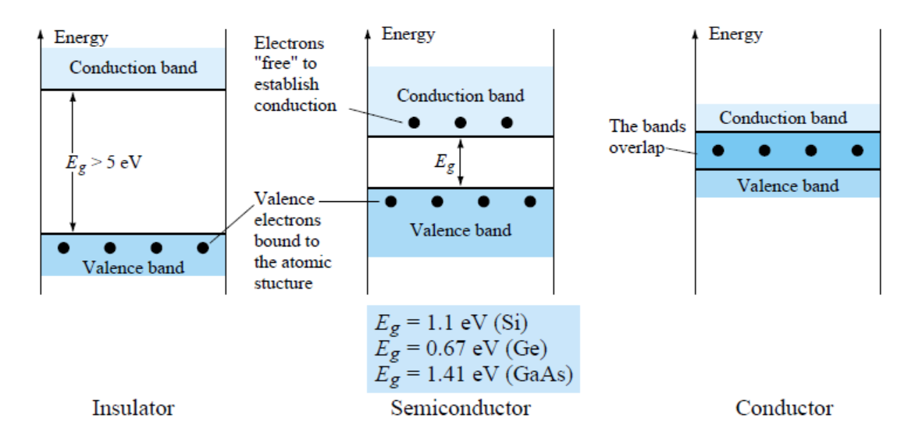
Classification of Materials based on Energy Band :

Slide 5
Some More Semiconductors
Ga As (1.42 eV)
Ga N
Al As
Ga P
Gp III: Al, Ga, In, Boron
Gp V: P, As, Sb, Bi

Slide 6
Intrinsic Semiconductors
Perfect crystal, No impurities or lattice defect
At absolute zero (0 K) –no carriers for charge transport
For temperature > 0 K , thermally excited carriers (EHP generation)

Slide 7
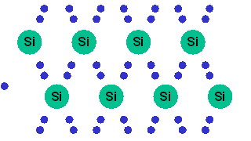
Intrinsic Silicon
At any temperature above absolute zero temperature, there is a finite probability that an electron in the lattice will be knocked loose from its position.

Slide 8
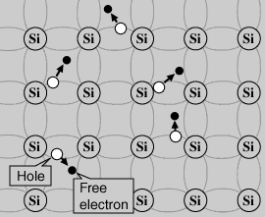
Intrinsic Silicon
The electron in the lattice knocked loose from its position leaves behind an electron deficiency called a "hole".

Slide 9
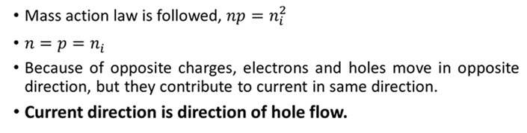
Law of mass action

Slide 10
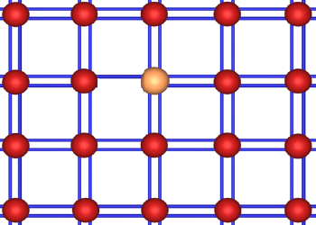
Doping
Doping (Process of adding an impurity to increase the conductivity of Semiconductor material ) can produce 2 types of semi-conductors depending upon the element added.

Slide 11
Doping
Doping (Process of adding an impurity to increase the conductivity of Semiconductor material ) can produce 2 types of semi-conductors depending upon the element added.
○ Two methods for introducing impurities into Si to control the majority-carrier type and resistivity of layers:
 Diffusion: dopant atoms move from the surface into Si by thermal means via substitutional or interstitial diffusion mechanisms.
 Ion implantation: dopant atoms are forcefully added into Si in the form of energetic ion beam injection.

Slide 12
Extrinsic Semiconductors
A semiconductor material that has been subjected to the doping process is called an extrinsic material.
There are two extrinsic materials : n-type and p-type.

Slide 13
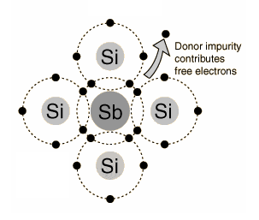
N-Type
Phosphorus and arsenic each have five outer electrons, so they're out of place when they get into the silicon lattice.
The fifth electron has nothing to bond to, so it's free to move around.

Slide 14
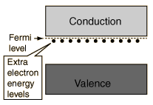
N-Type
It takes only a very small quantity of the impurity to create enough free electrons to allow an electric current to flow through the silicon. N-type silicon is a good conductor.
Electrons have a negative charge, hence the name N-type.

Slide 15
N-Type Material
The n-type is created by introducing those impurity elements that have five valence electrons (pentavalent), such as antimony, arsenic, and phosphorus.
Diffused impurities with five valence electrons are called donor atoms.
In an n-type material the electron is called the majority carrier and the hole the minority carrier.

Slide 16
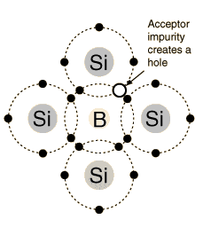
P-Type Doping
Boron and gallium each have only three outer electrons.
When mixed into the silicon lattice, they form "holes" in the lattice where a silicon electron has nothing to bond to.

Slide 17
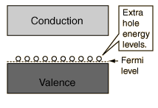
P-Type Doping
The absence of an electron creates the effect of a positive charge, hence the name P-type.
Holes can conduct current. A hole happily accepts an electron from a neighbor, moving the hole over a space. P-type silicon is a good conductor.

Slide 18
P type material
The p-type material is formed by doping a pure germanium or silicon crystal with impurity atoms having three valence electrons, such as boron, gallium, and indium.
The diffused impurities with three valence electrons are called acceptor atoms.
In a p-type material the hole is the majority carrier and the electron is the minority carrier.

Slide 19
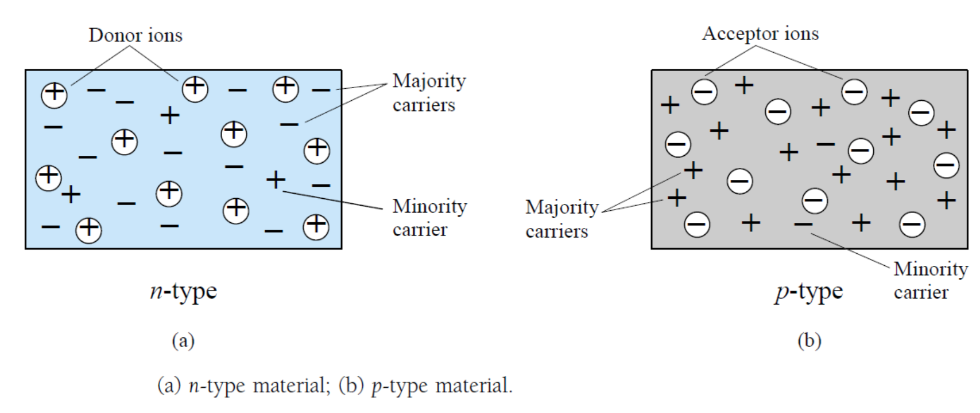
Majority and Minorities carriers :

Slide 20
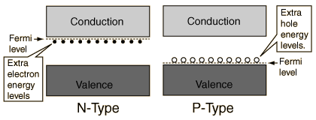
P-N Junction
In the n-type region there are extra electrons and in the p-type region, there are holes from the acceptor impurities .

Slide 21
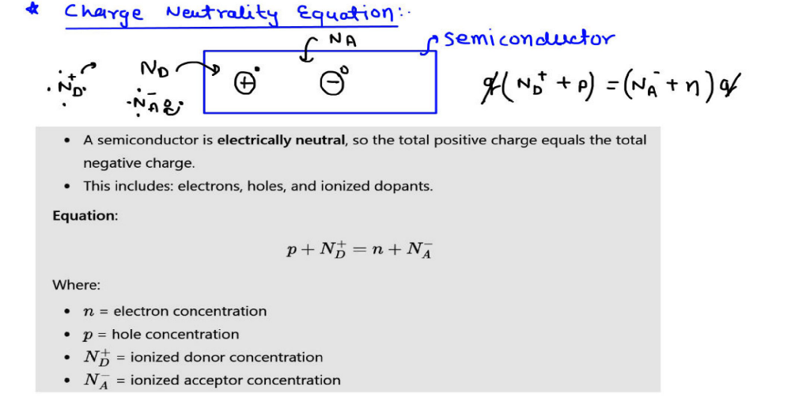
P-N Junction

Slide 22
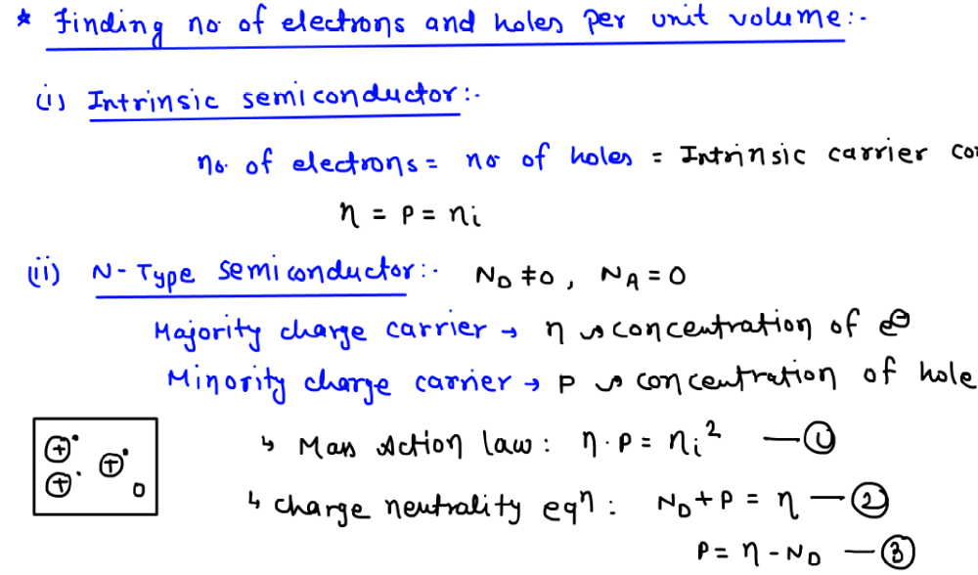

P-N Junction

Slide 23
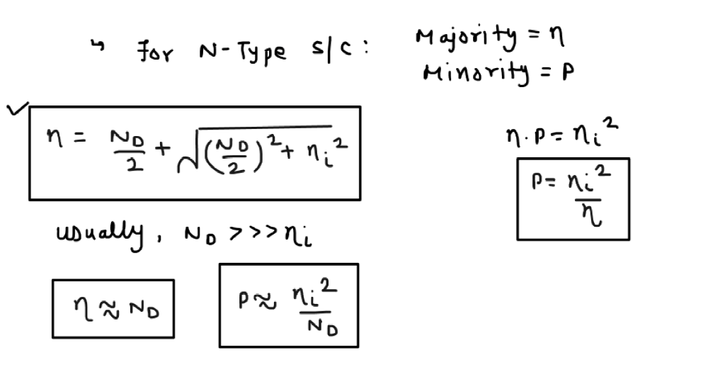
P-N Junction

Slide 24
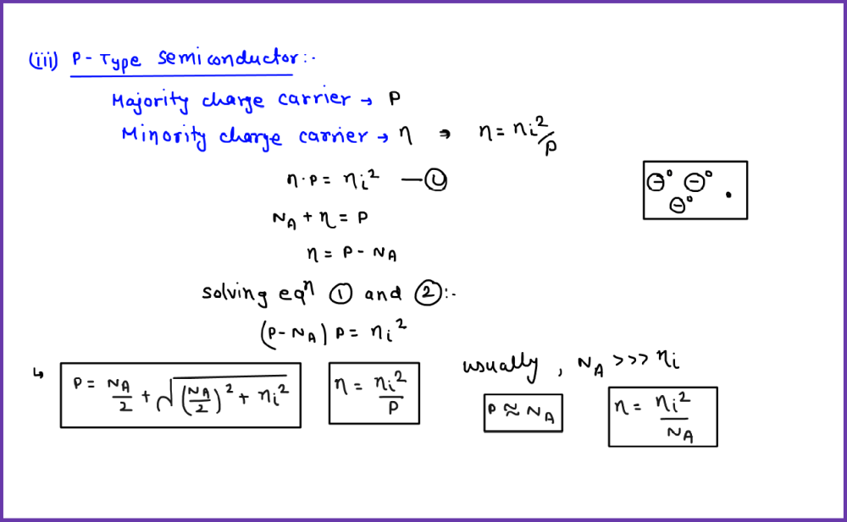
P-N Junction

Slide 25
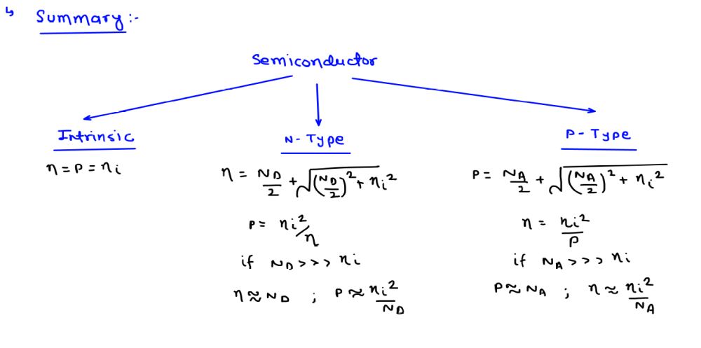
P-N Junction

Slide 26
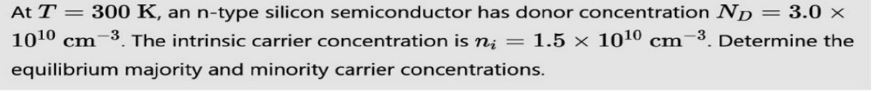

P-N Junction
For an Ntype semiconductor with Donor impurity Nd given.
Total number of electronics (n) = Donor concentration (Nd)

Slide 27
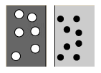

P-N Junction
In the p-type region there are holes from the acceptor impurities and in the n-type region there are extra electrons.
P Type
N Type

Slide 28
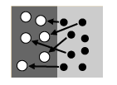
P-N Junction
When a p-n junction is formed, some of the electrons from the n-region which have reached the conduction band are free to diffuse across the junction and combine with holes.
N_{a} -
N_{d} +
P Type
N Type

Slide 29
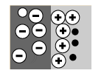
P-N Junction
Filling a hole makes a negative ion and leaves behind a positive ion on the n-side.
E
A space charge builds up, creating a depletion region.

Slide 30
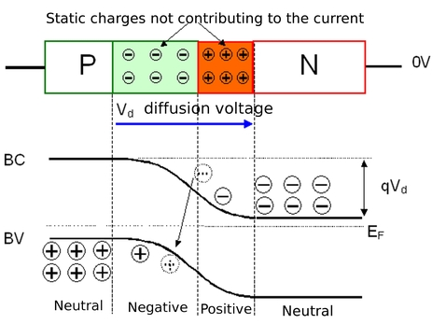
P-N Junction
This causes a depletion zone to form around the junction (the join) between the two materials.
This zone controls the behavior of the diode.

Slide 31
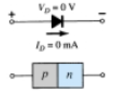
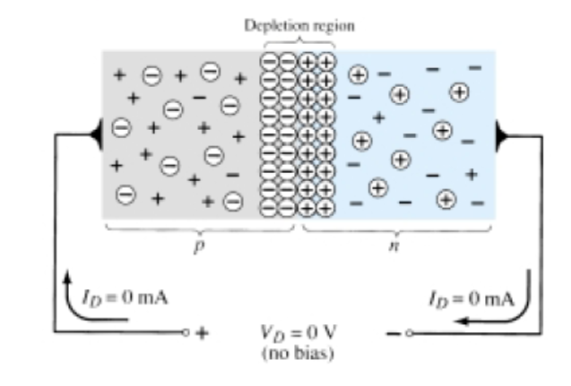
P-N junction Diode
In the absence of an applied bias voltage, the net flow of charge in any one direction for a semiconductor diode is zero
This causes a depletion zone to form around the junction (the join) between the two materials.
This zone controls the behavior of the diode.

Slide 32
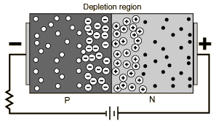
Reverse biased p-n junction
A semiconductor diode is Reverse-biased when the association p-type and negative and n-type and positive has been established.
The application of a reverse voltage to the p-n junction will cause a transient current to flow as both electrons and holes are pulled away from the junction.

Slide 33
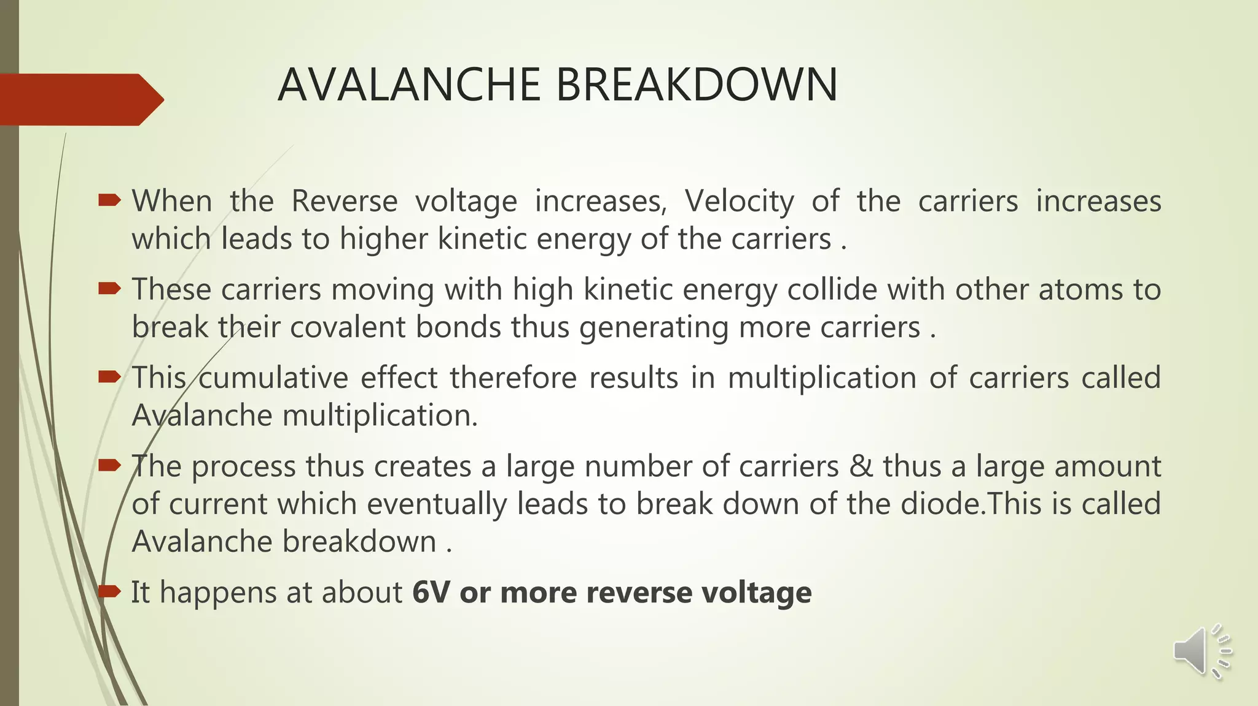
Reverse biased p-n junction

Slide 34
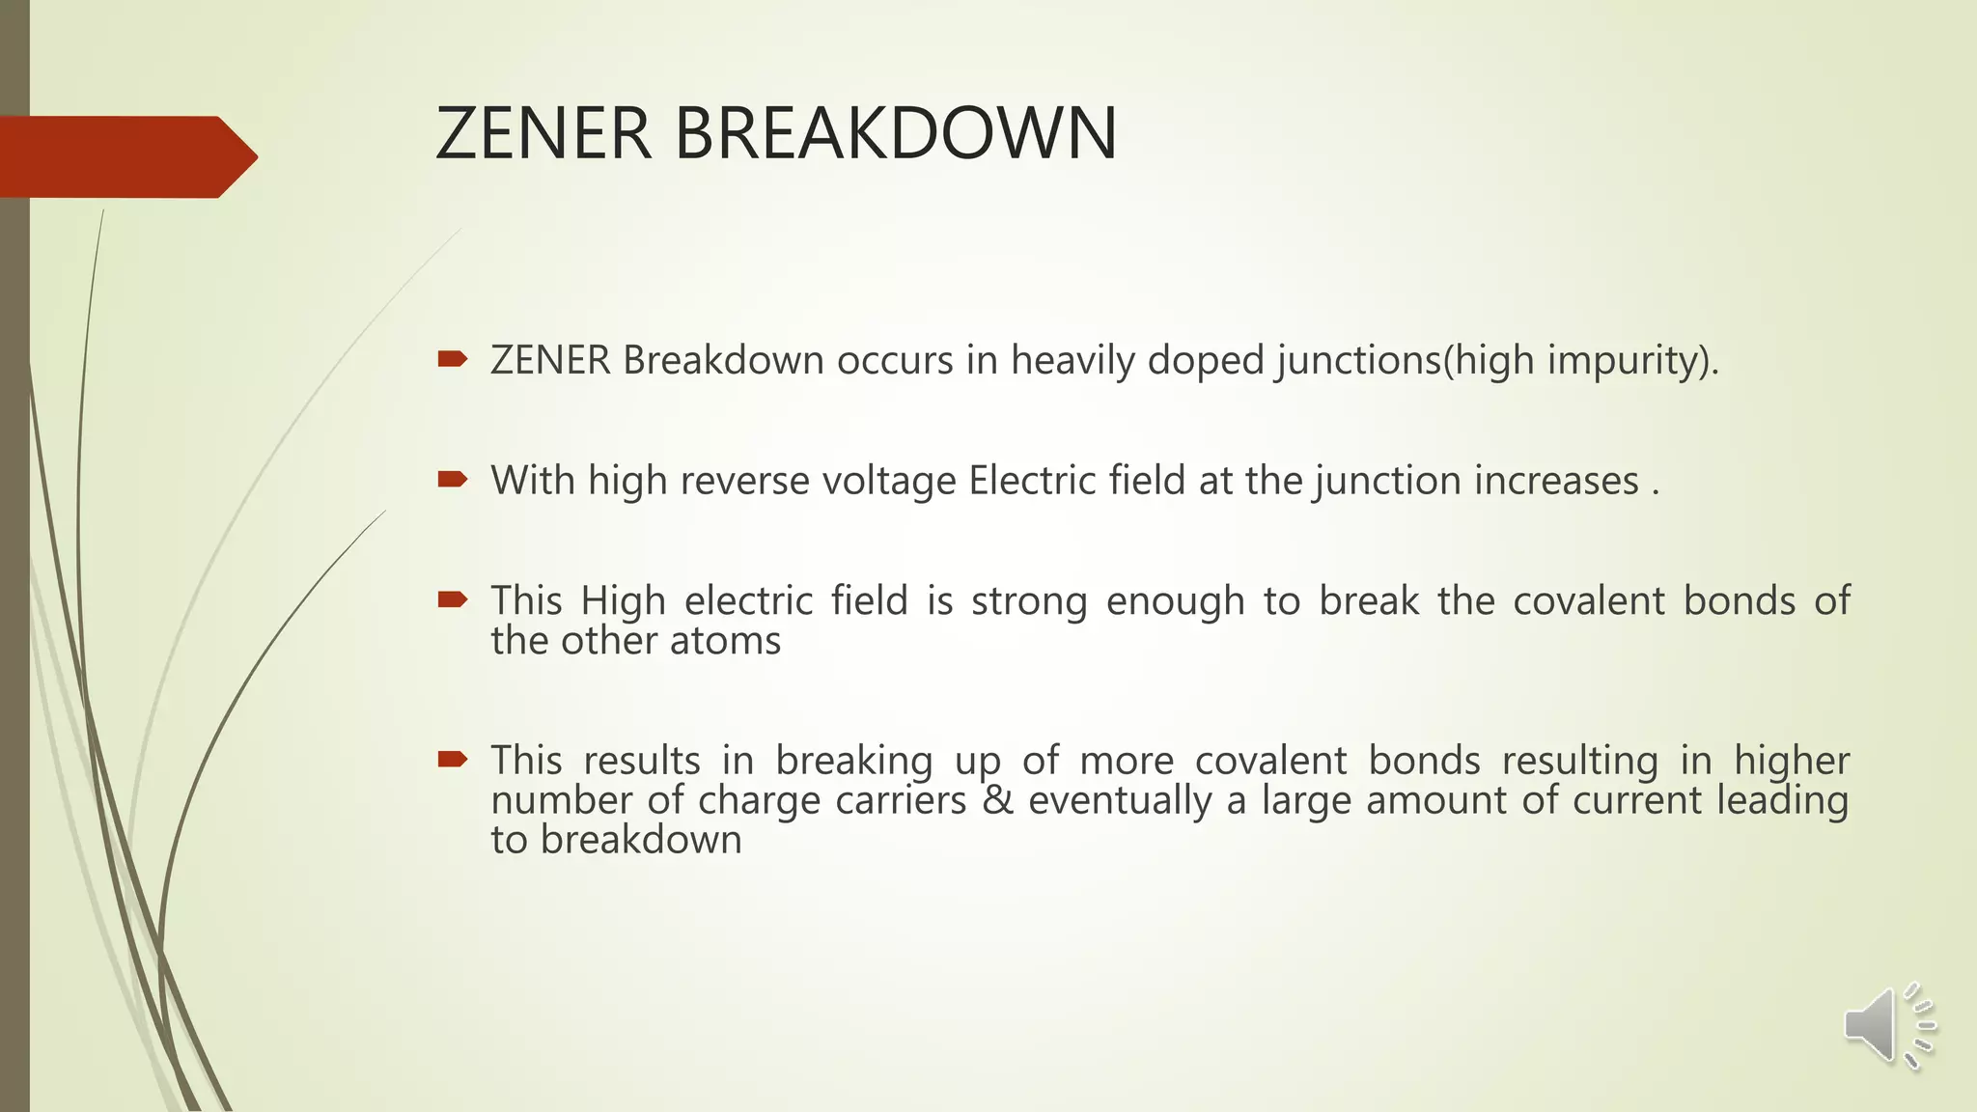
Reverse biased p-n junction

Slide 35
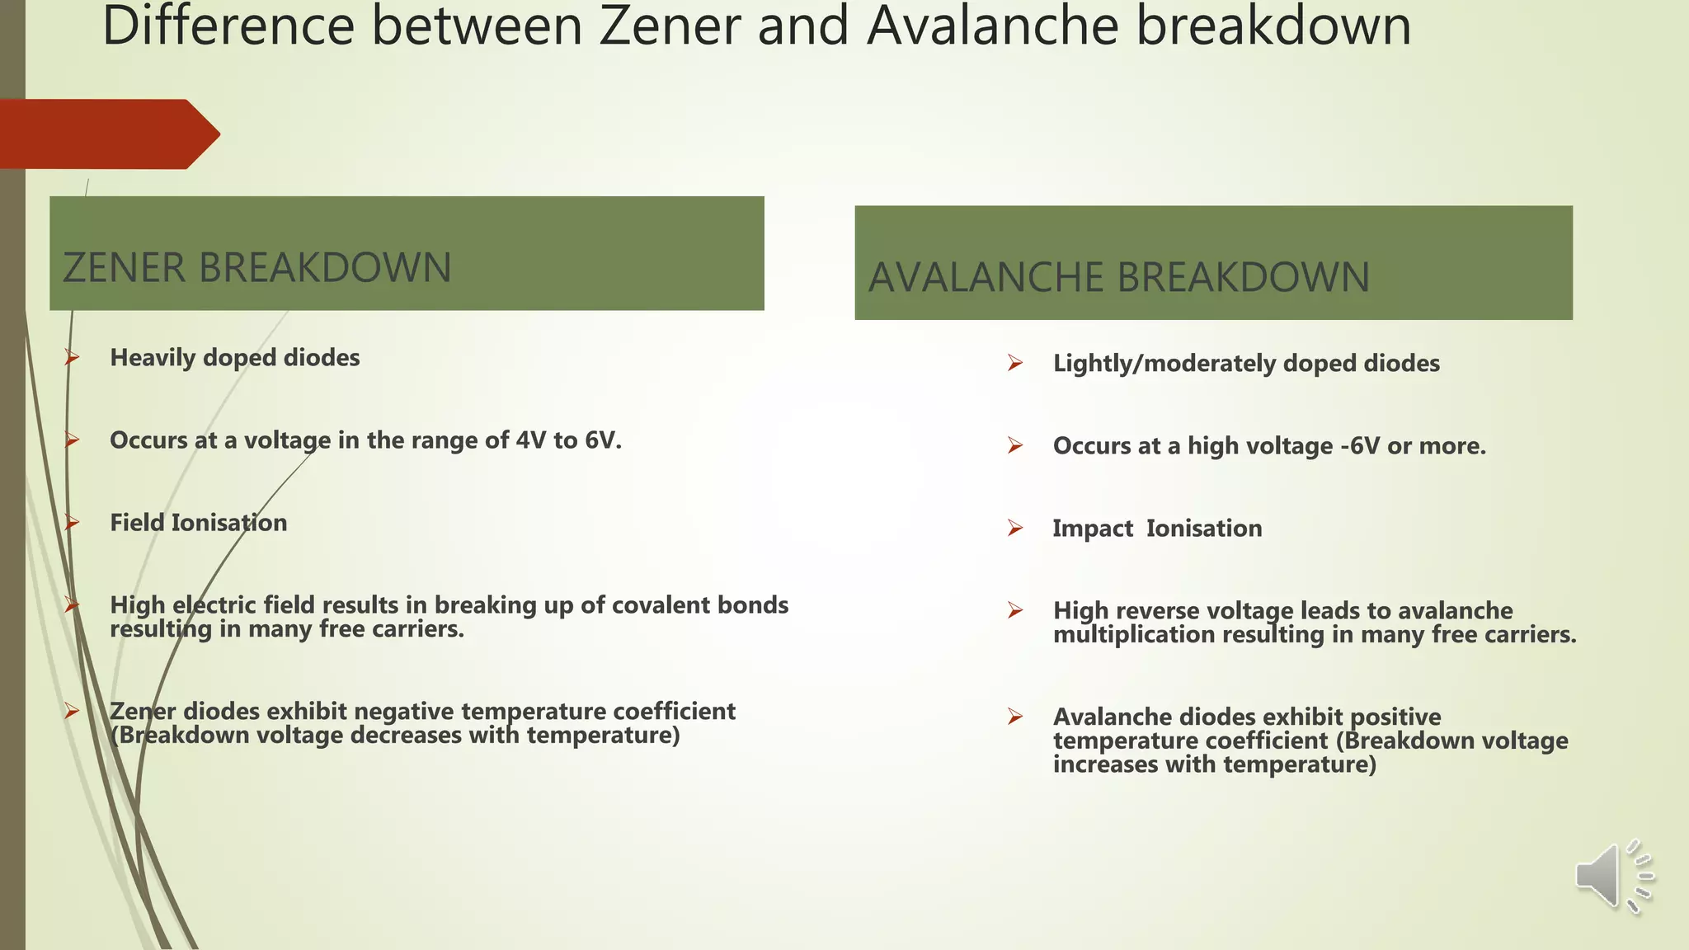
Reverse biased p-n junction

Slide 36
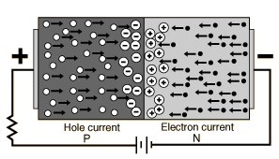
Forward biased p-n junction
A semiconductor diode is forward-biased when the association p-type and positive and n-type and negative has been established.
Forward biasing the p-n junction drives holes to the junction from the p-type material and electrons to the junction from the n-type material.

Slide 37

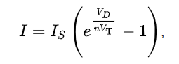
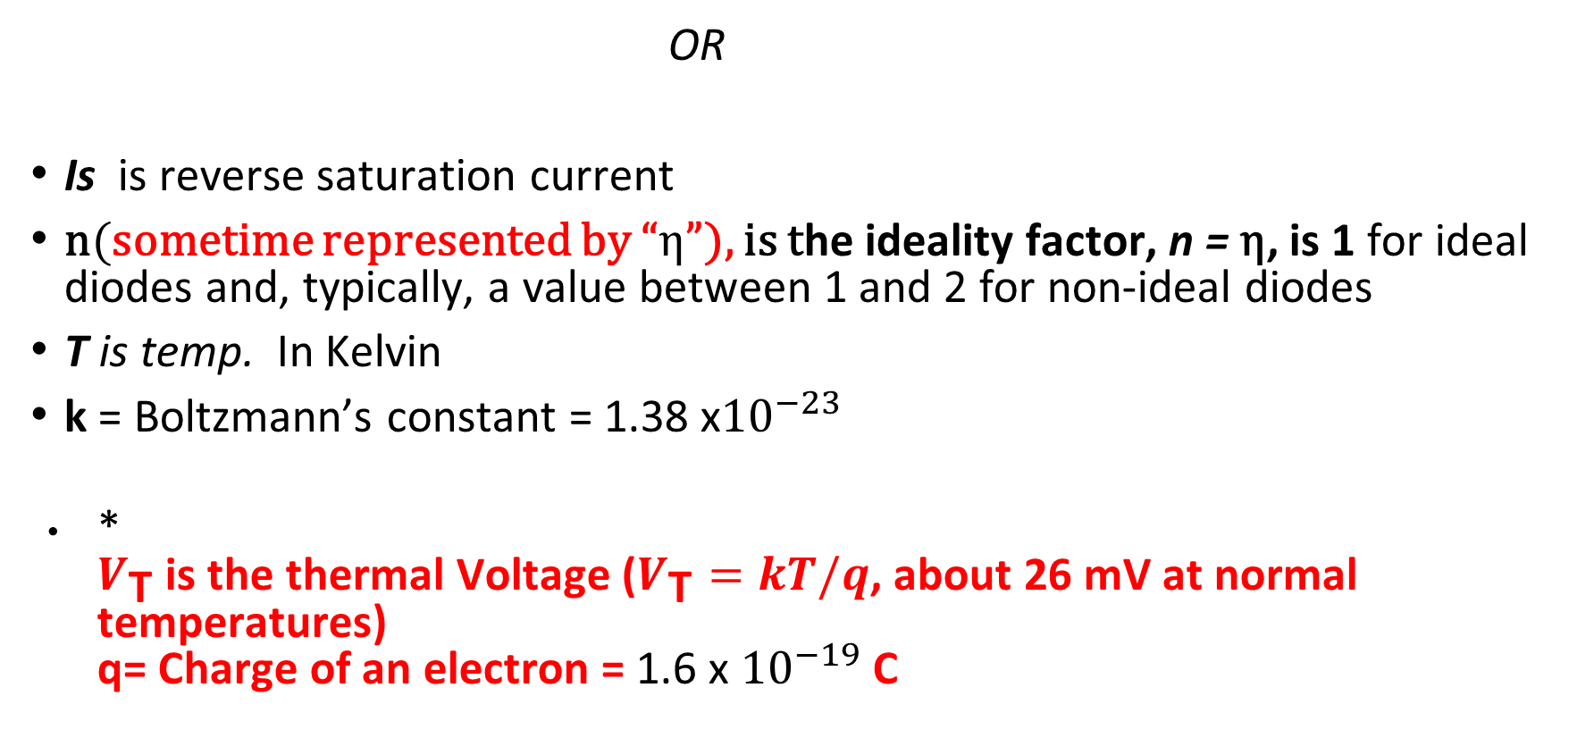

Diode Forward Current
OR
Is is reverse saturation current
n(sometime represented by “η”), is the ideality factor, n = η, is 1 for ideal diodes and, typically, a value between 1 and 2 for non-ideal diodes
T is temp. In Kelvin
k = Boltzmann’s constant = 1.38 x${10}^{−23}$
*
$V_{\text{T}}$ is the thermal Voltage ($V_{\text{T}}=kT/q$, about 26 mV at normal temperatures)
q= Charge of an electron = 1.6 x ${10}^{−19}$ C

Slide 38
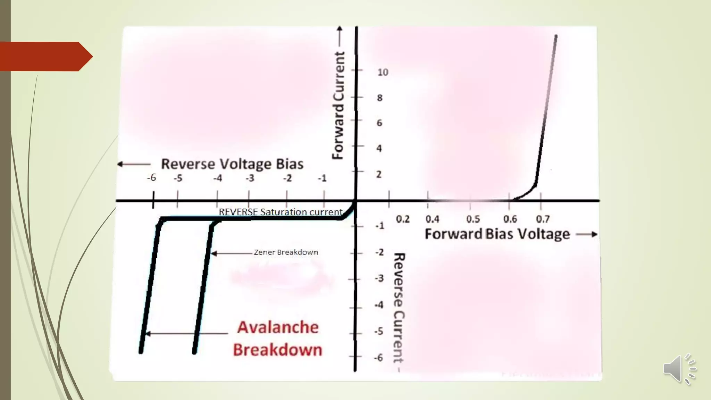
Reverse biased p-n junction

Slide 39
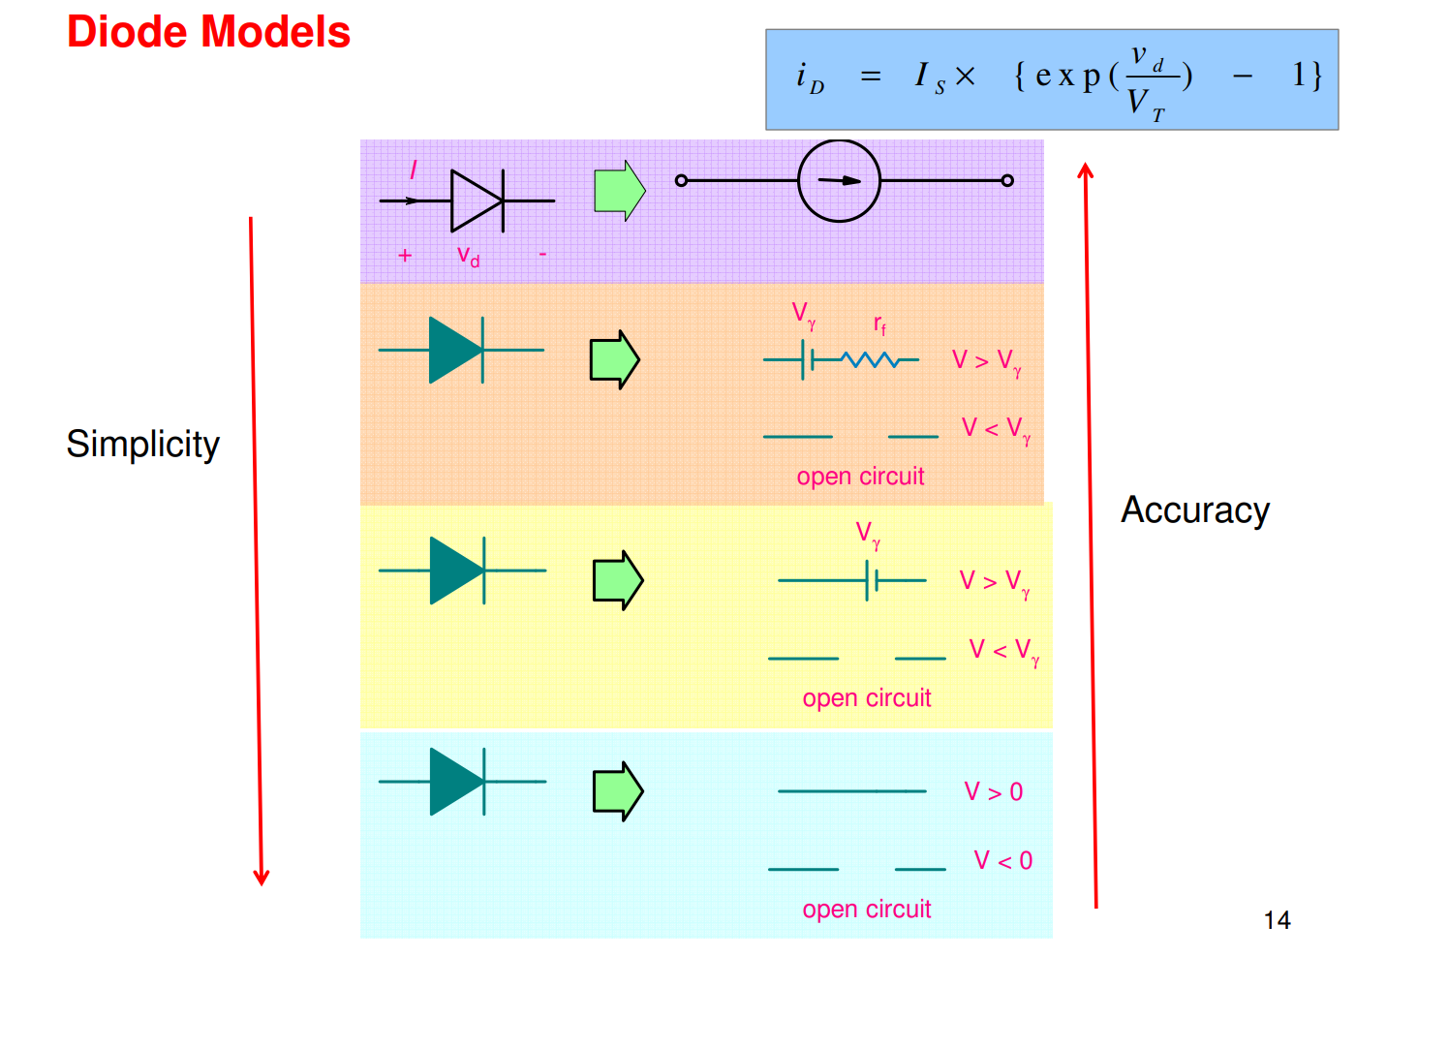




Slide 40
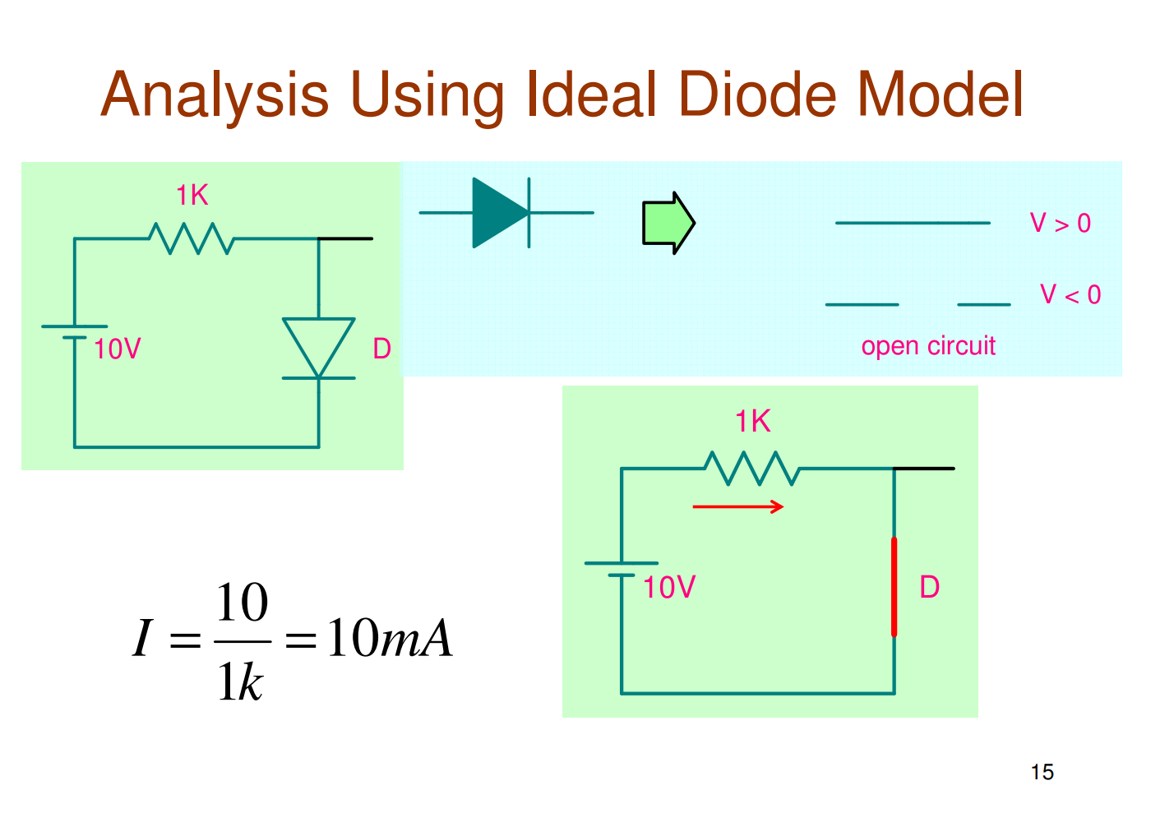
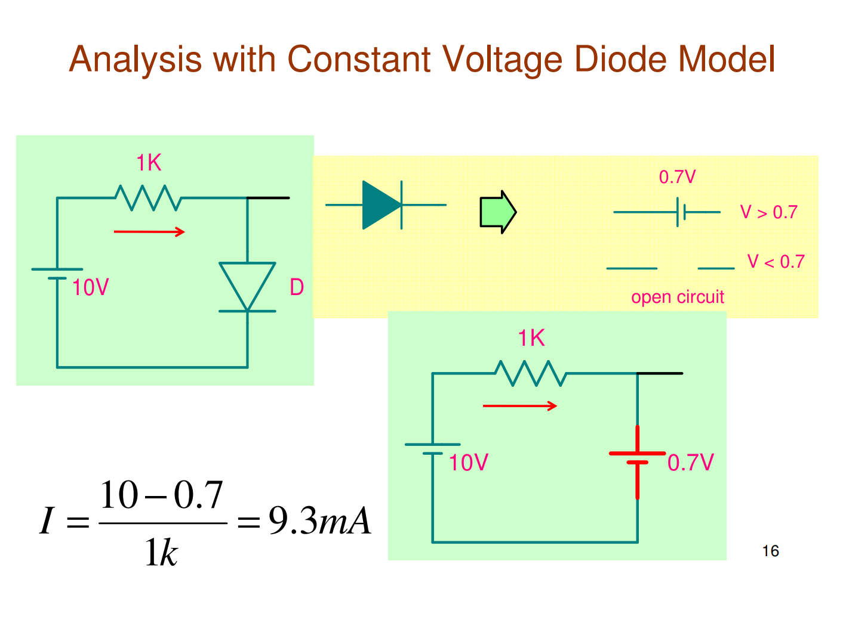
Using diode models

Slide 41
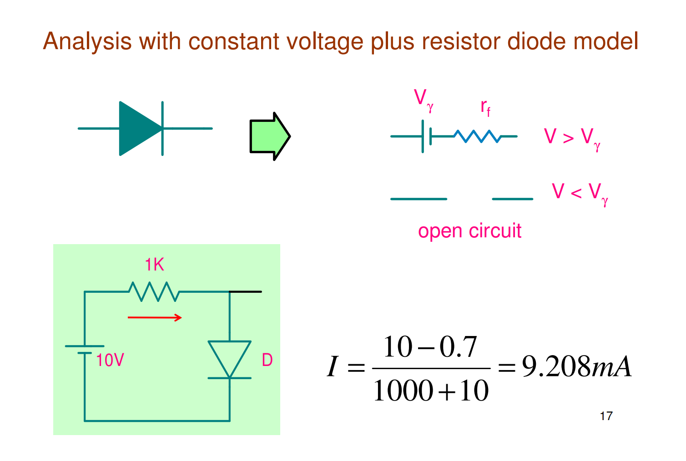
Using diode model (contd..)

Slide 42
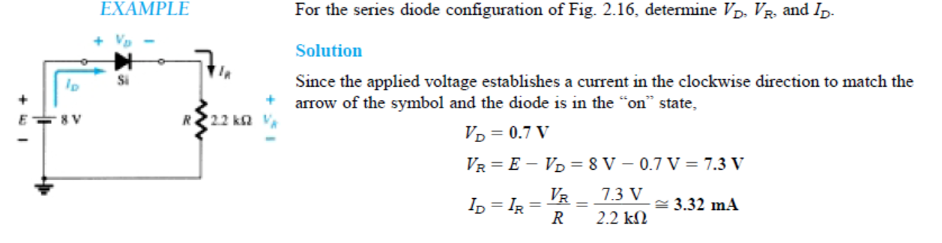

Slide 43
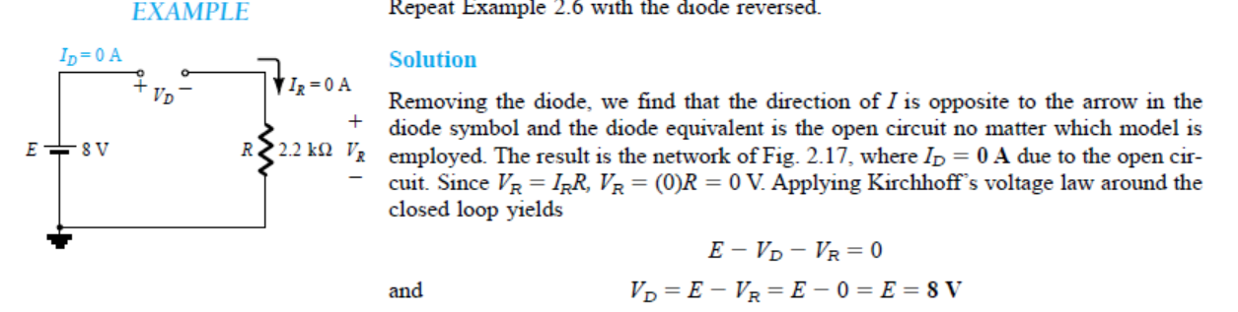

Slide 44
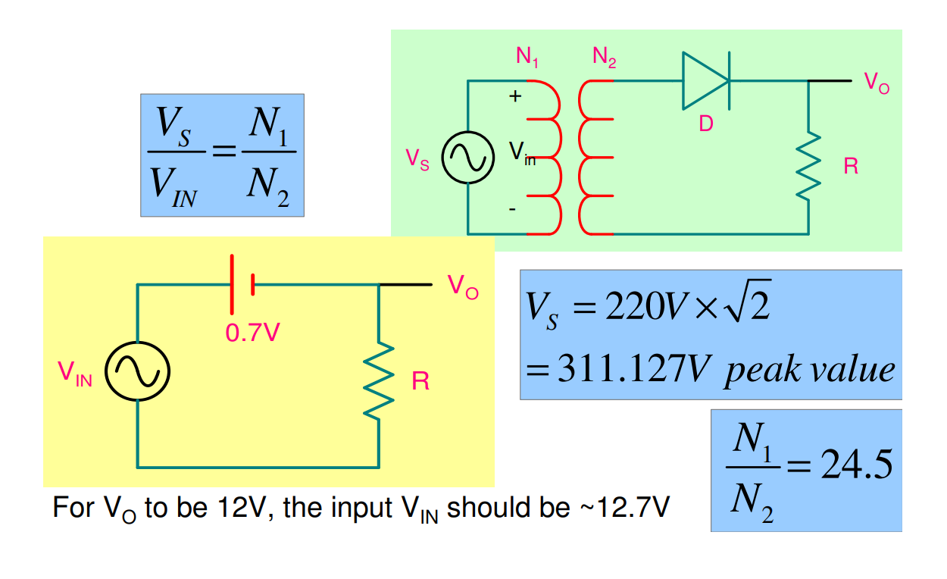


Diode as Half wave rectifier

Slide 45
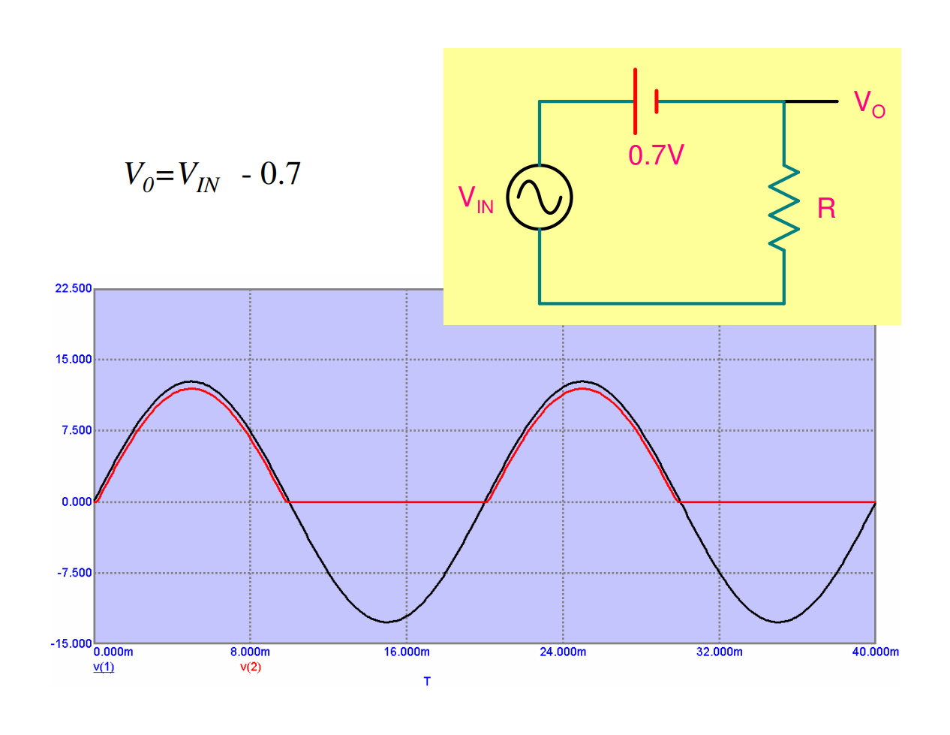
HW rectifier : Output waveform
When Reverse baised , the maximum voltage across diode known as Peak Inverse Voltage (PIV)
PIV Half wave rectifier = Vs (i.e. Max voltage across secondary of transformer or Maximum of input voltage if transformer is not present )

Slide 46
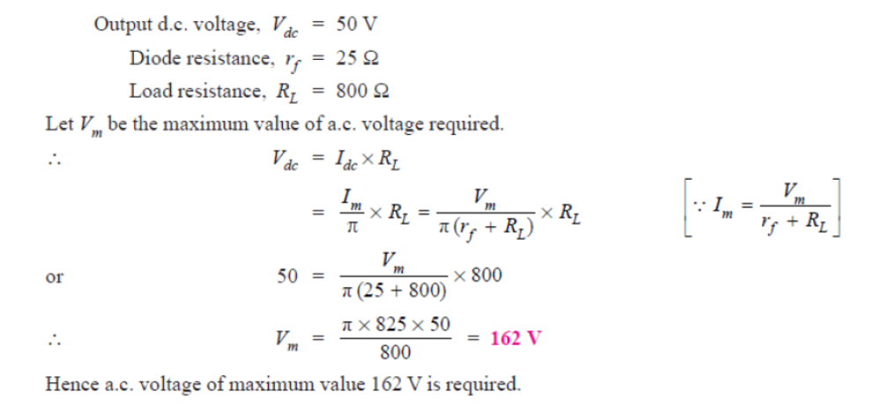

HW rectifier : Output waveform
A half-wave rectifier is used to supply 50V d.c. to a resistive load of 800 Ω. The diode has a resistance of 25 Ω. Calculate a.c. voltage required.
I_{m} = Peak value of load current
Vdc = Vm/$П$

Slide 47
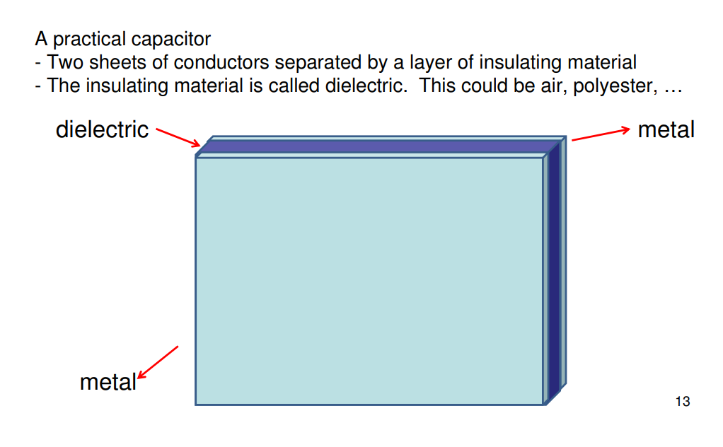
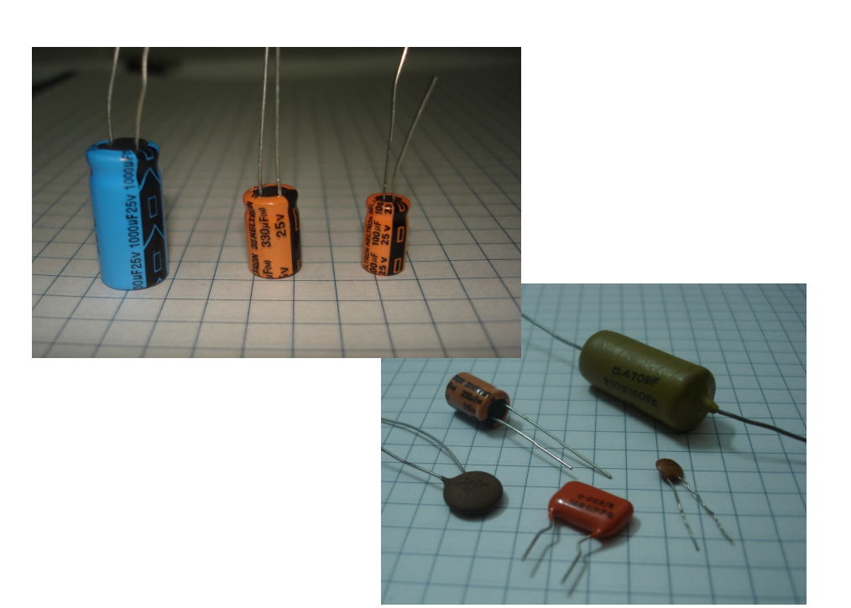
Capacitors

Slide 48
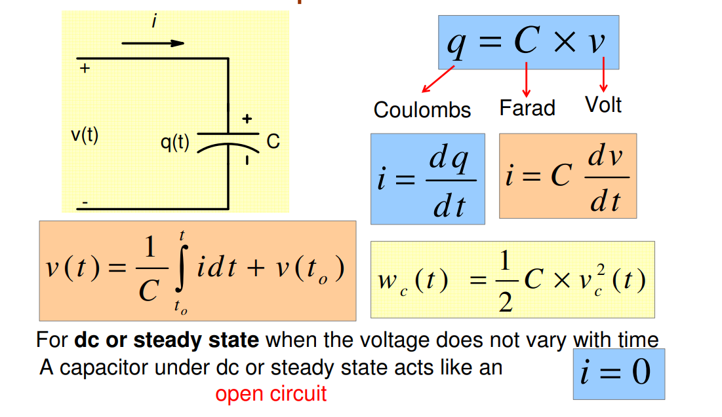
Capacitance

Slide 49
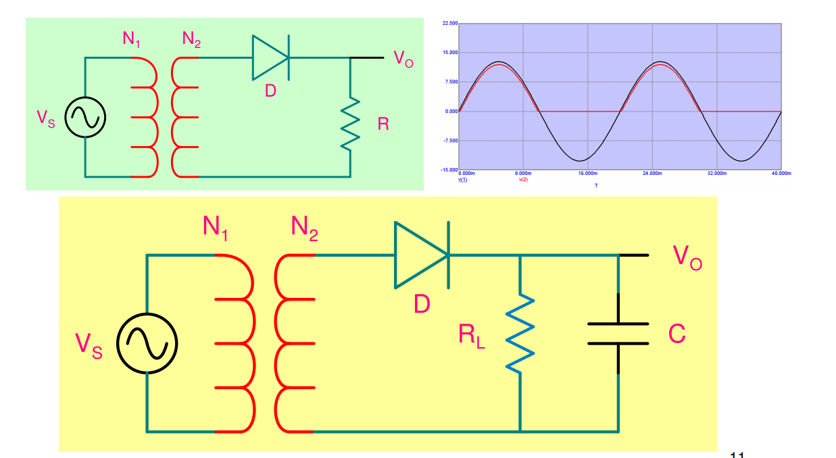

Ripple filter

Slide 50
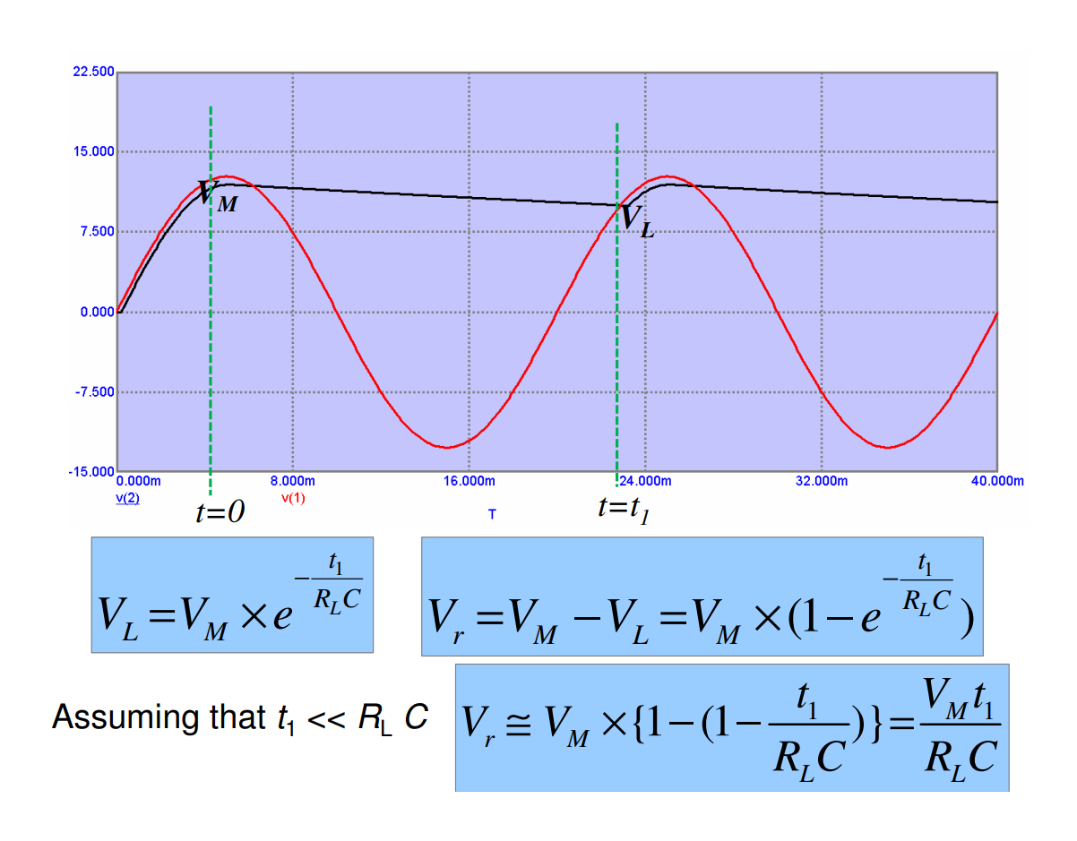
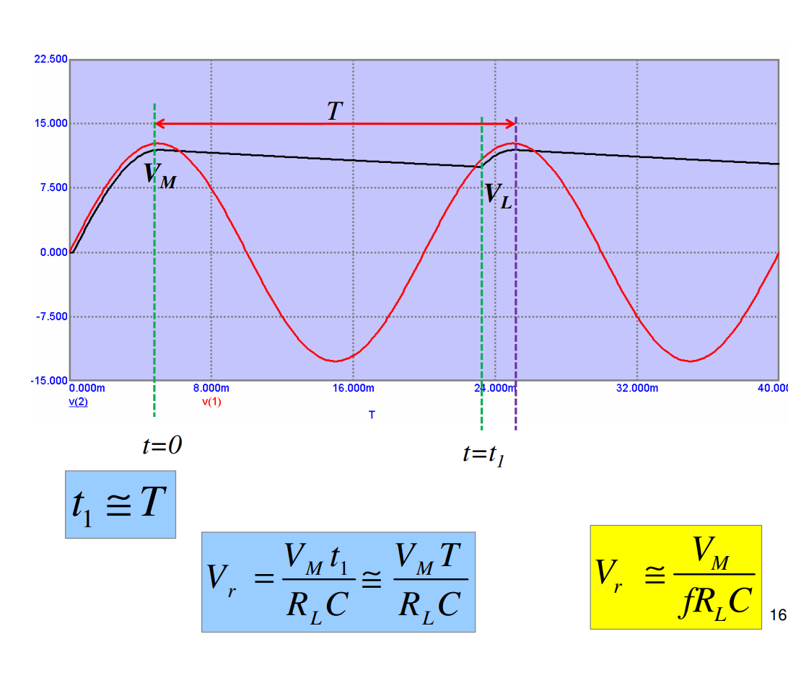

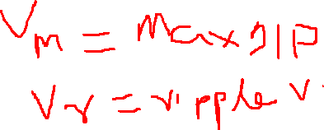
Ripple factor (cont.)
Ripple factor can be quantified using the following formula:
Vrms = RMS of Input and Vdc= Output Dc voltage

Slide 51
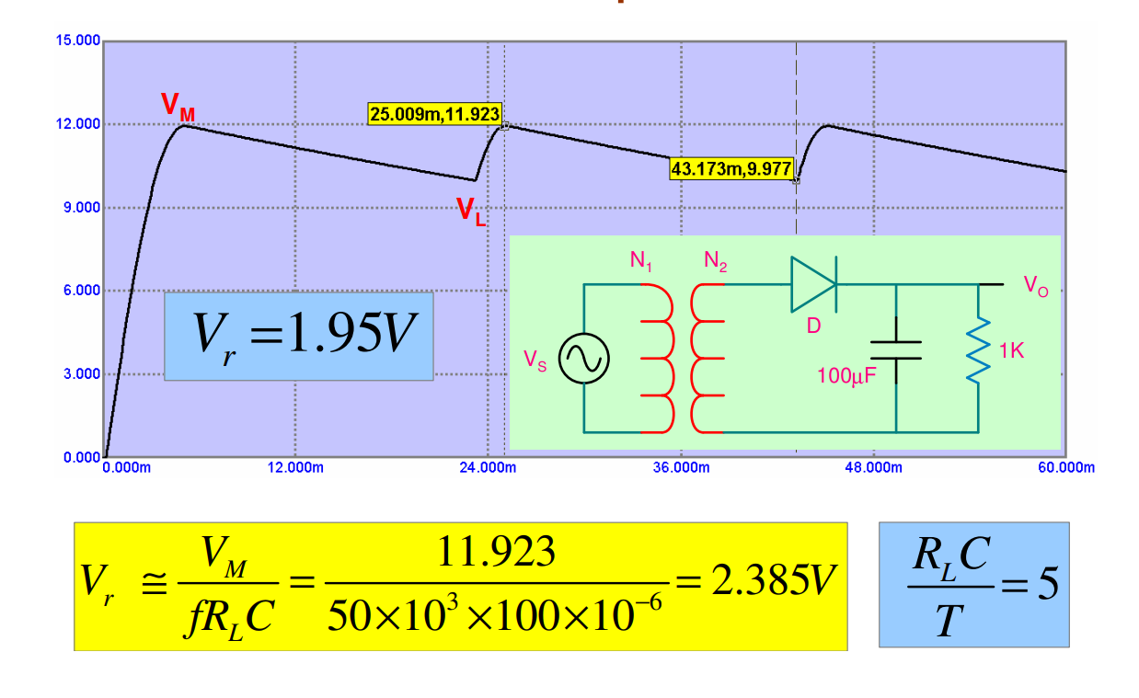
Example

Slide 52
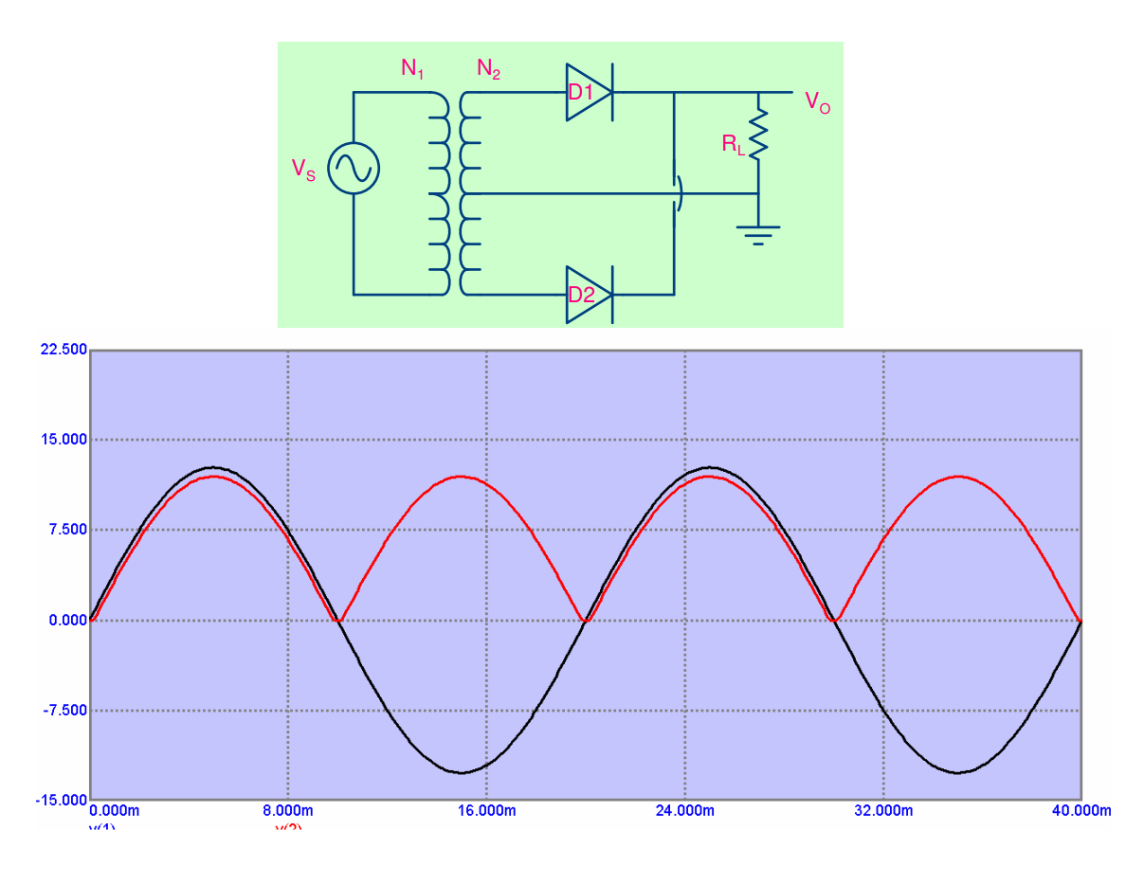
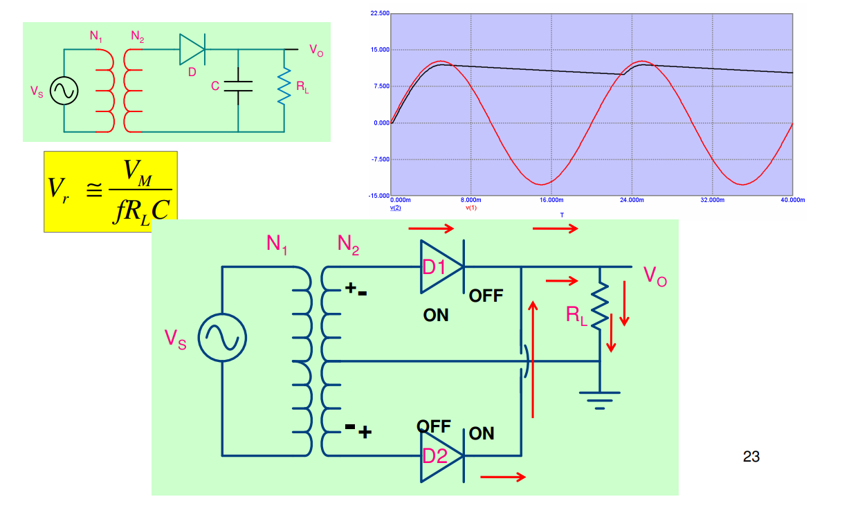

Full wave rectifier

Slide 53




Full wave rectifier
Average/Mean value of Rectified Output voltage
RMS value of Rectified Output voltage
Average/Mean value of Rectified Output voltage
rf is the forward resistance of diode

Slide 54



Full wave rectifier: Ripple factor

Slide 55



Bridge Rectifier

Slide 56

Ripple factor: Bridge Rectifier

Slide 57


Peak Inverse Voltage

Slide 58

Bridge rectifier

Slide 59

Comparison

